Slide 1
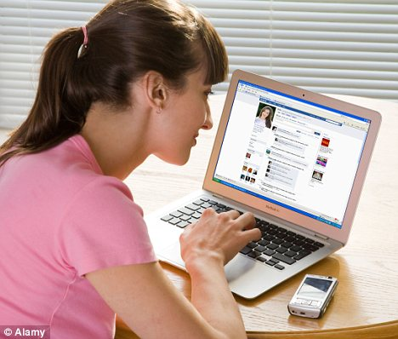
Involved in
Taking care of family and home.
Key Responsibilities
Home life is hectic for Alice as she has all the children and home responsibilities.
Alice Wonderland
Stay at home mom
Staying connected to friends and family
She tries to stay connected to friends and family through sharing posts and liking and commenting on their posts.
IT/Technical Knowledge
Web/Social Media Usage
Language Editing
Eye for the Details
Video Development
Drivers
Tech Profile
Option paralysis
Sometimes she gets overwhelmed by the many ways to share and connect through the facebook app
Frustrations

